Slide 1


About Compilation Errors
When a stored program is submitted for creation, it is submitted to a compilation process.
If successful, the program unit is ready for execution.
If compilation fails due to errors, the source code is still stored within the data dictionary but an error message is displayed.
Warning: execution completed with warning
FUNCTION salary_valid Compiled.

Slide 2
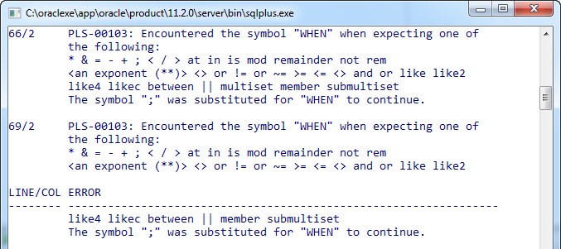
Generating an Error Report
All compilation errors are stored in the dictionary view USER_ERRORS. While you can directly query this view, you can also use the SHOW ERRORS command.

Slide 3
Generating an Error Report (cont)
You can also generate a report for any stored procedure by appending the type and name of the object you wish to view.
The object types are: FUNCTION, PROCEDURE, PACKAGE, PACKAGE BODY and TRIGGER.
Note: This command can be issued from SQL*Plus or SQL Developer
SHOW ERRORS PROCEDURE error_salary

Slide 4

See it in Action

